Slide 1
Relational databases
Aidan Moore

Slide 2
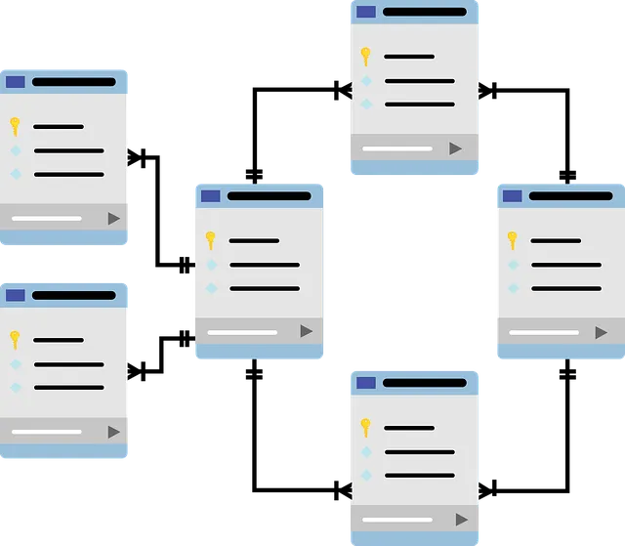
Relational Database
A relational database consists of one or more tables, with any number of rows and columns.
Each table represents an entity. And column are named records.
Data is then entered into the tables.
Relations can then be created between the tables to retain data consistency.
Figure – 1 E-R

Slide 3
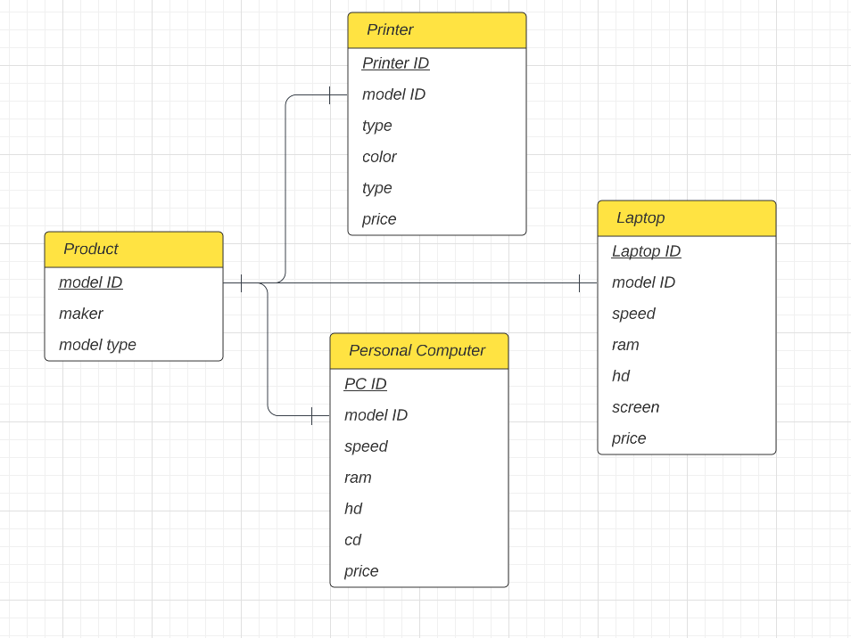
Primary keys underlined. Primary keys are mandatory to uniquely identify a records entered into the database.
For example two sales of a the same product can be distinguished from each other.

Slide 4
Types of relations
One to one - One record in table A is related to one record in table B.
One to many - One record in table A is related to many record entries in table B.
Many to many - Many records in table A is related to many records in table B. Often split into a new table with foreign keys and one to many relations.

Slide 5
Entity–relationship model
Foreign keys share name with a primary key in a different table.
Figure – 1 E-R

Slide 6
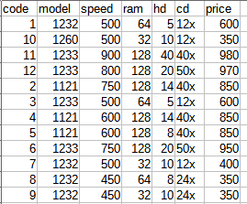
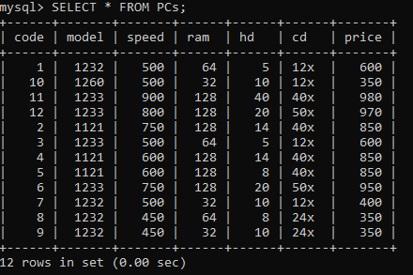
Setup in MySQL
As a test environment the example data was imported into a MySQL server. Converted from the csv format given.

Slide 7
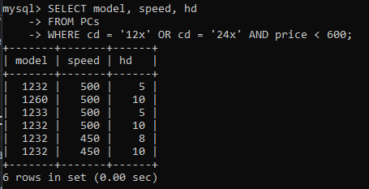
Find the model number, speed, and hard drive size of PCs with a 12x or 24x CD drive
SELECT model, speed, hd
FROM PCs
WHERE cd = ‘12x’ OR cd = ‘24x’ AND price < 600

Slide 8
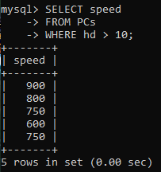
Find the processing speed of each manufacturer of laptops with a hard drive capacity of at least 10 GB.
SELECT speed
FROM PCs
WHERE hd > 10

Slide 9
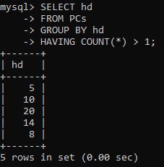
Find hard drive capacities that are identical for two or more computers
SELECT hd
FROM PCs
GROUP BY hd
HAVING COUNT(*) > 1;

Slide 10
No-SQL alternative
Not all databases have to be relational,

Slide 11
Thanks for listening

